Slide 1




Chop chop brothers
SALES CONVERSION OPTIMIZATION
PROJECT
Presented by: ARYAN and PARTH

Slide 2

Overview
About the Dataset
Goals
Problem Statement
Solution with EDA and M.l model
Dashborad

Slide 3

About the Dataset
The data used in this project is from an anonymous organisation’s social media ad campaign. The file contains 1143 observations in 11 variables with 0 null values and 0 duplicates:
1.) ad_id: an unique ID for each ad.
2.) xyz_campaign_id: an ID associated with each ad campaign of XYZ company.
3.) fb_campaign_id: an ID associated with how Facebook tracks each campaign.
4.) age: age of the person to whom the ad is shown.
5.) gender: gender of the person to whim the add is shown
6.) interest: a code specifying the category to which the person’s interest belongs (interests are as mentioned in the person’s Facebook public profile).
7.) Impressions: the number of times the ad was shown.
8.) Clicks: number of clicks on for that ad.
9.) Spent: Amount paid by company xyz to Facebook, to show that ad.
10.) Total conversion: Total number of people who enquired about the product after seeing the ad.
11.) Approved conversion: Total number of people who bought the product after seeing the ad.
https://www.kaggle.com/datasets/loveall/clicks-conversion-tracking/data

Slide 4


Goals
Data Analysis using Buisness Questions
Dashboard
EDA for Fb campaign
Cluster Analysis for Ad Conversions Data
Using python for EDA and answering the question.

Slide 5




Problem Statment
Question 1
How can one enhance the performance of social ad campaigns to achieve the maximum conversion rate, focusing on optimizing Reach to Conversion ratios and Click to Conversion ratios?
Question 2
How can we identify the ideal target demographics by considering the appropriate clickthrough rates, defined as ClickToImpPer (Clicks/Impressions)?
Question 3
What is the optimal decision-making time per age group for conversion and future retargeting in social campaigns?
Question 4
Assessing individual campaign performances to identify the most effective creative/campaign for potential reruns with adjusted audiences.

Slide 6
IMPORTANT LIBRARIES AND TOOLS
Numpy - library used for working with arrays
Pandas- library for data analysis
Matplotlib -library for creating static and interactive visualization
Seaborn-data visualization library based on matplotlib
Sk-learn - library that implements range of machine learning algorithms.
SCIPY - library that implements range of Statistical Analysis
POWER BI - for Dashboard creation

Slide 7
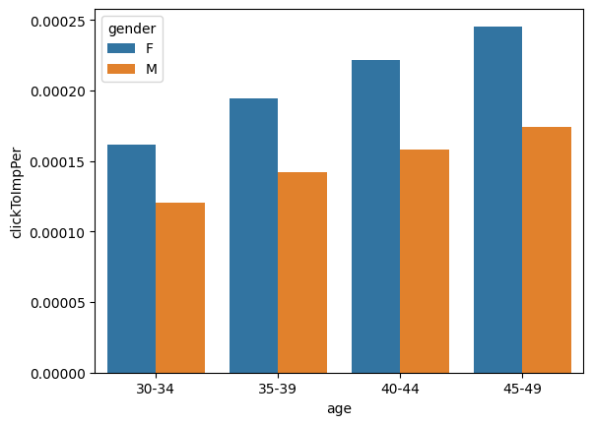
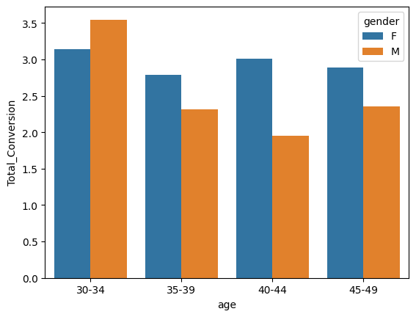
Question 1:
How can one enhance the performance of social ad campaigns to achieve the maximum conversion rate, focusing on optimizing Reach to Conversion ratios and Click to Conversion ratios?
1) Individuals in the age range of 45-49 exhibit a higher Click to Impression ratio, indicating a tendency to click on ads more frequently than other age groups. Additionally, females in each age group have a higher Click to Impression ratio compared to their male counterparts.
1. Click to Impression vs age
2. Total Conversion vs age

Slide 8
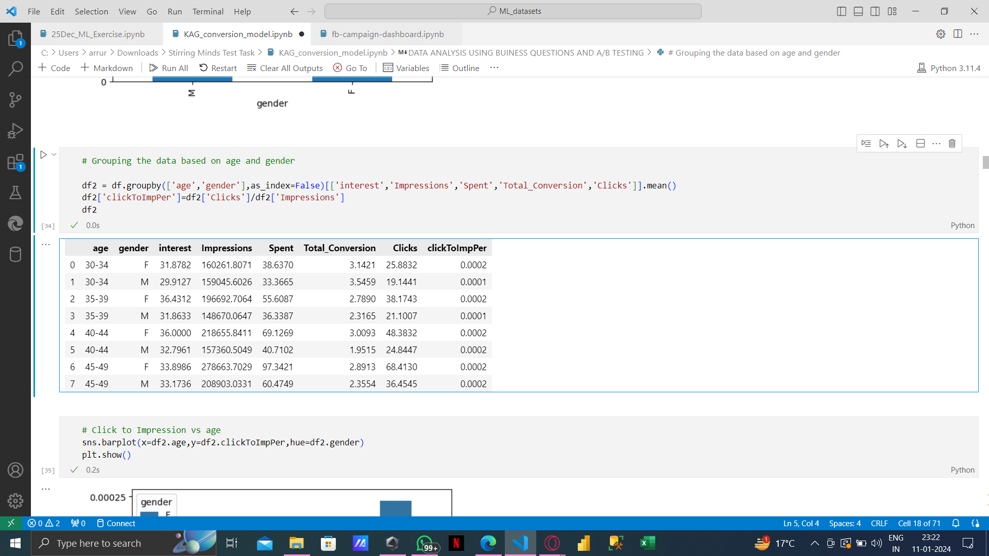
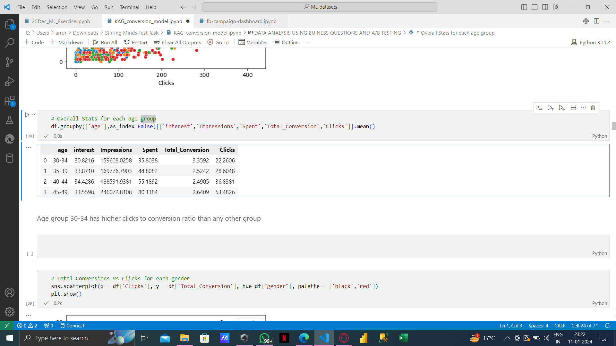
2)In the age group of 30-34, there is a higher total conversion per click than any other age group. Furthermore, this age group demonstrates a superior clicks to conversion ratio compared to other groups.
Notably, for males, the total conversion per clicks is higher than for females.

Slide 9
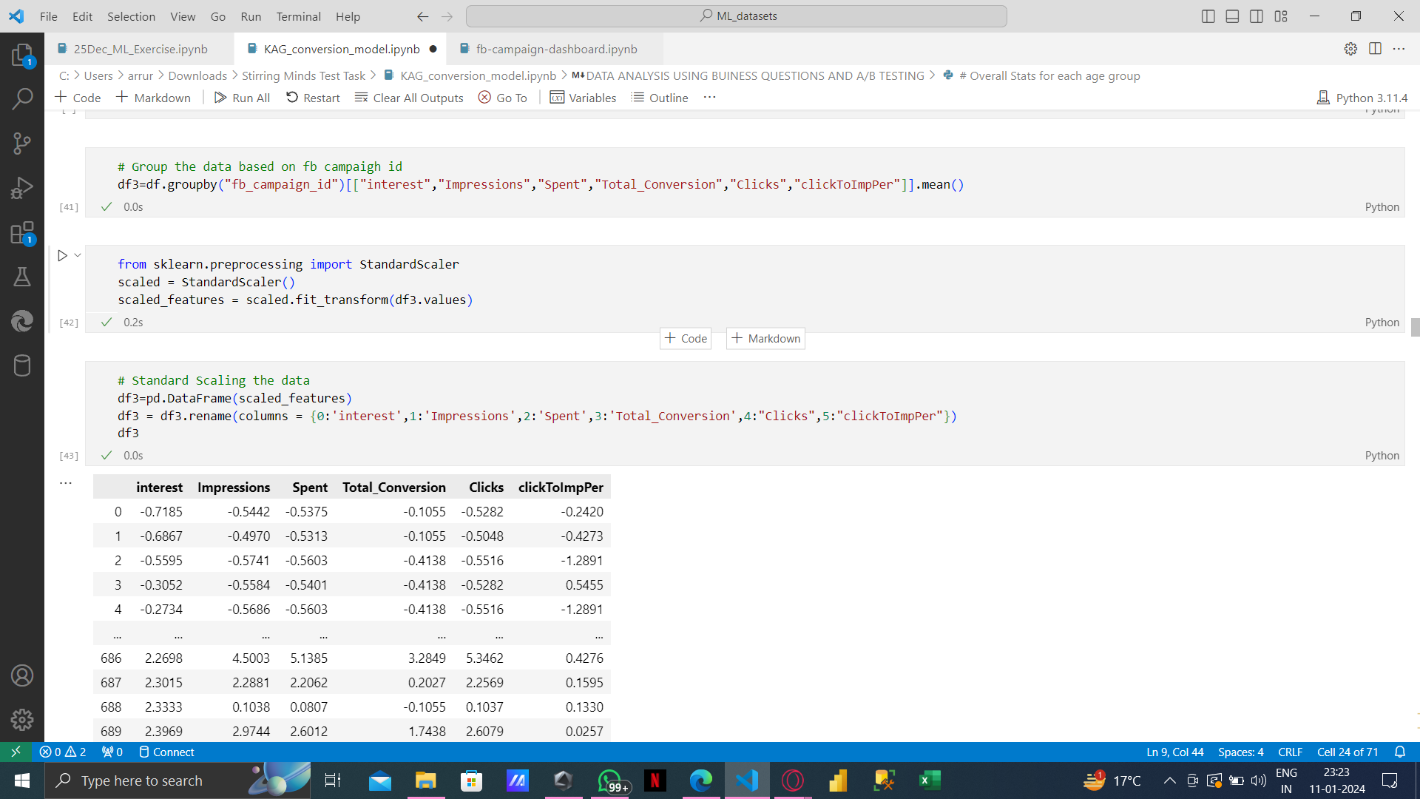
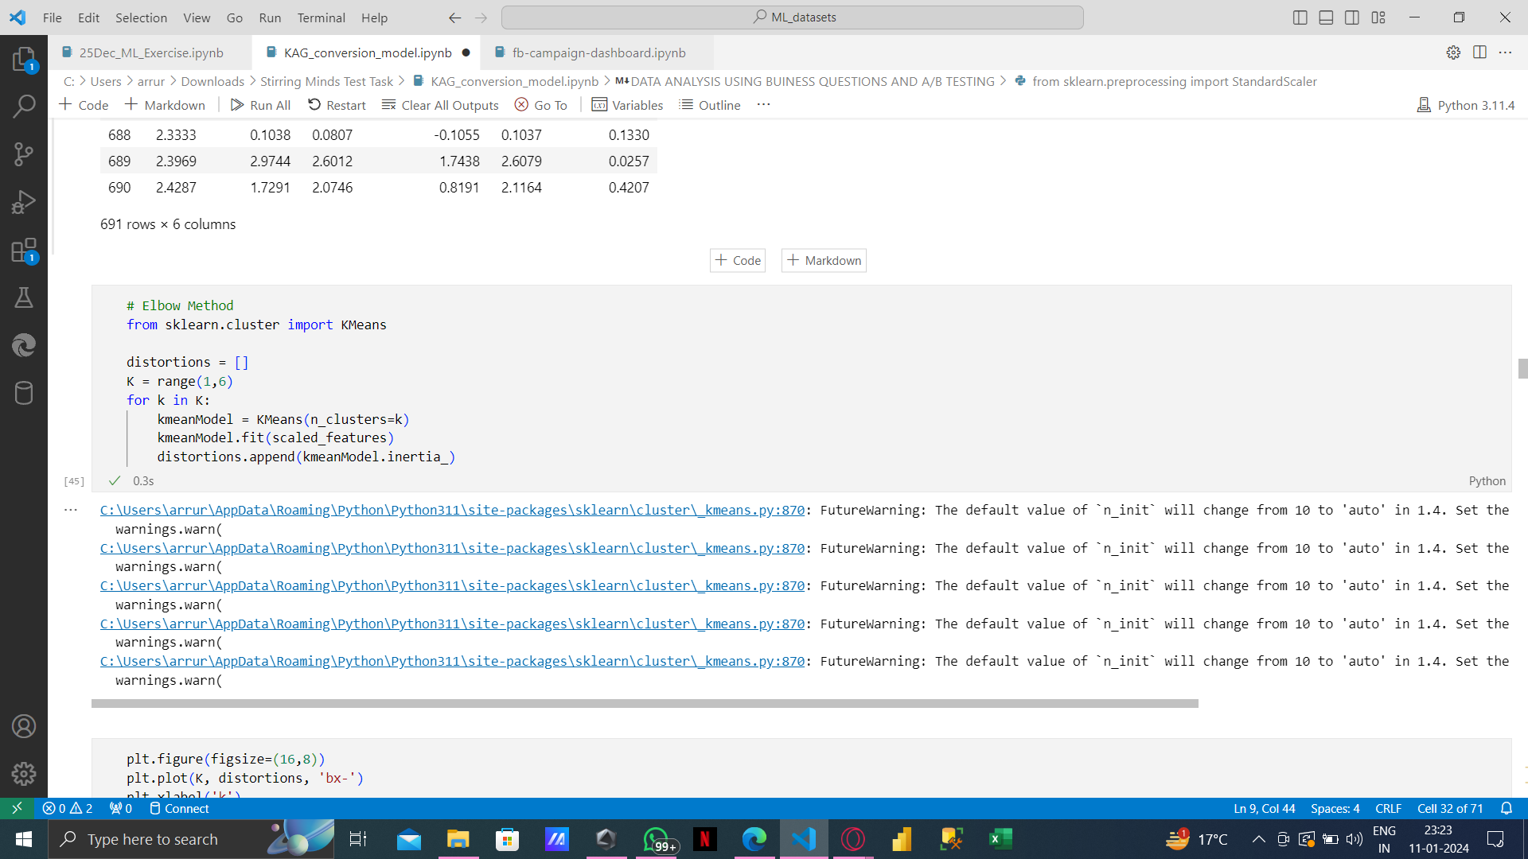
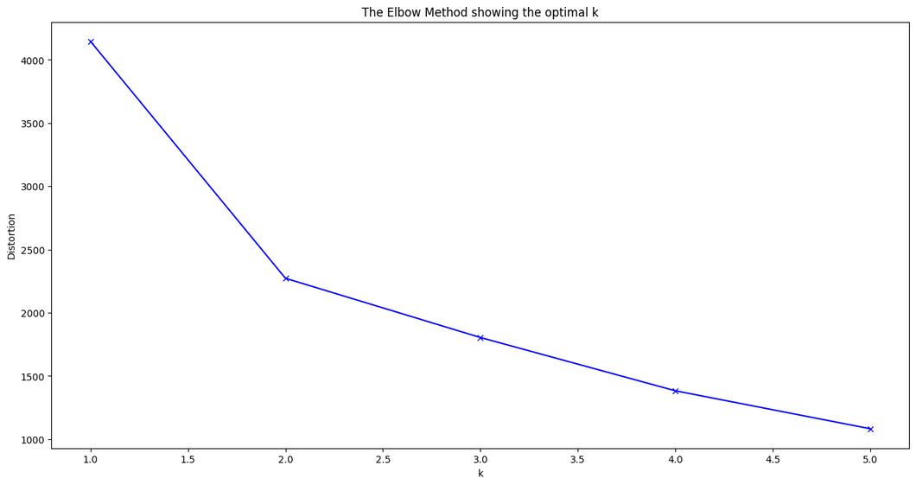
Using the elbow method we can clearly see that the optimal number of clusters are 2

Slide 10
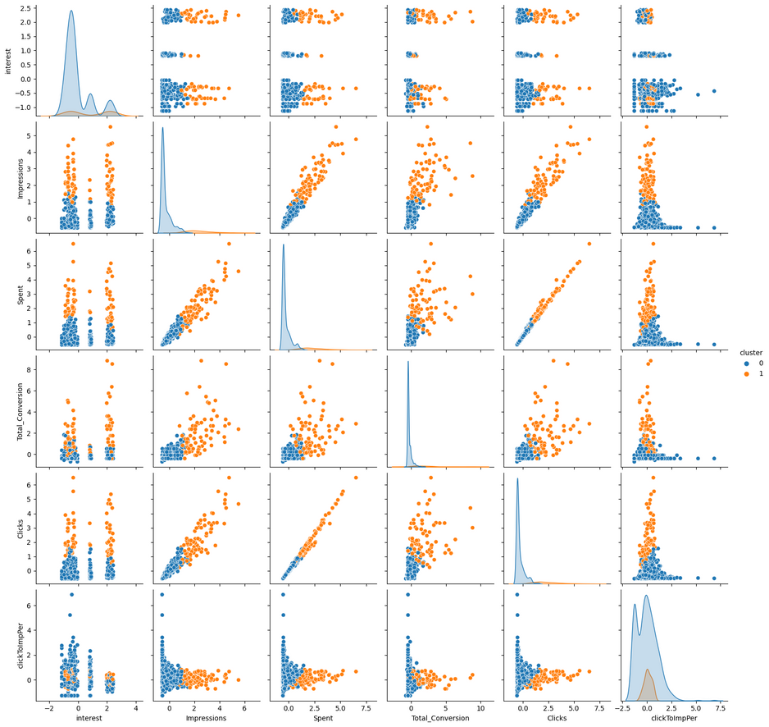
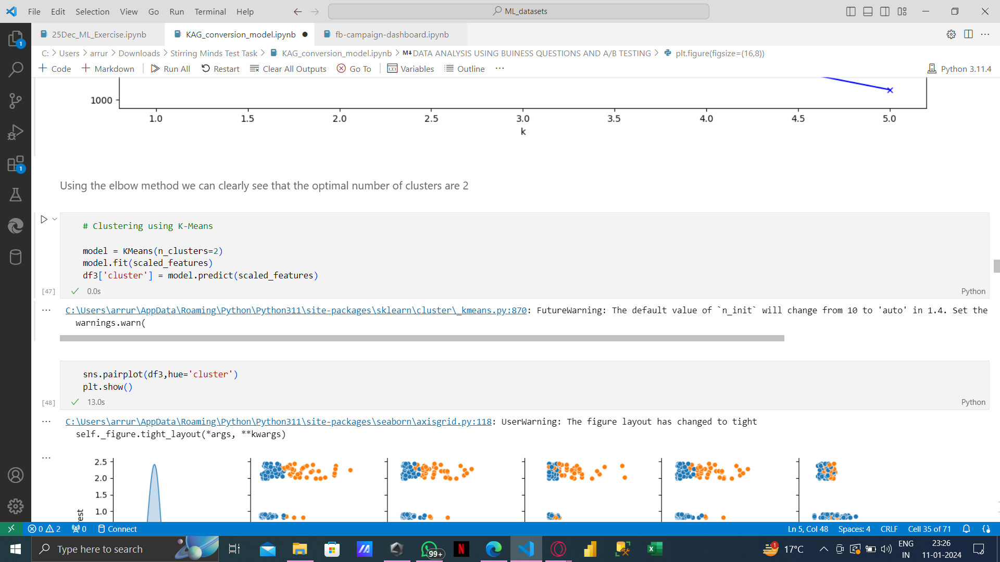
In summary, the analysis reveals that Cluster 1 (the orange cluster) represents Facebook ad campaigns that are already optimized, while Cluster 0 (the blue cluster) requires optimization. The performance of the orange cluster surpasses that of the blue cluster. Therefore, there is a clear opportunity to enhance the ad campaigns in Cluster 0 for a better click to conversion ratio.

Slide 11
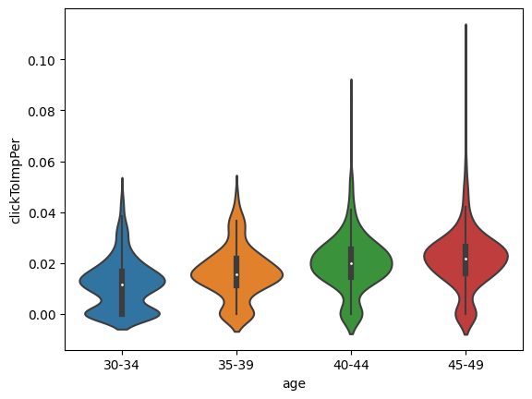
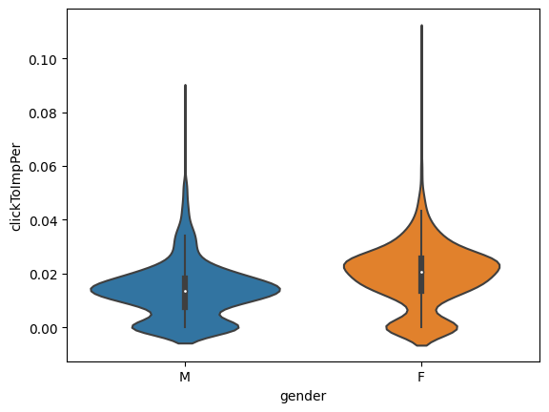
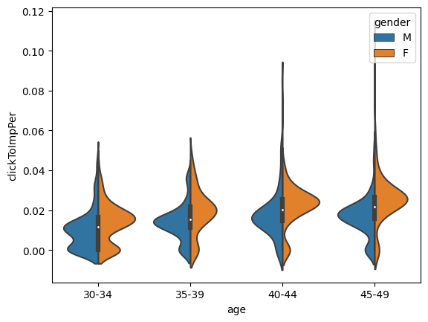
Question 2:
How can we identify the ideal target demographics by considering the appropriate clickthrough rates, defined as ClickToImpPer (Clicks/Impressions)?
Click to Impression vs age
Click to Impression vs gender
Click to Impression vs age for each gender
The demographic segments characterized by higher clickthrough rates include females aged 45-49 and females aged 40-44.

Slide 12
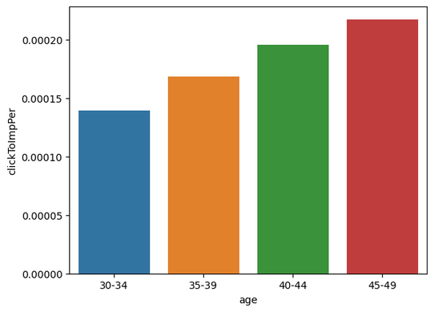
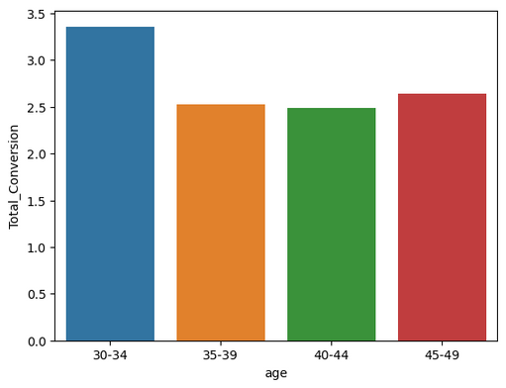
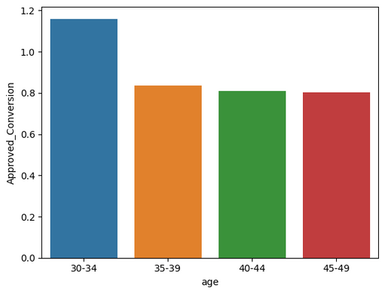
Question 3:
What is the optimal decision-making time per age group for conversion and future retargeting in social campaigns?
Click to Impression vs age
Total Conversion vs age
Approved Conversions vs age
1. The age group 45-49 demonstrates a higher Click to Impression ratio, indicating a greater frequency of clicking on ads compared to other age groups.
2. Despite a lower click-to-impression ratio, individuals in the 30-34 age group exhibit high total conversions, suggesting increased product inquiries compared to other age groups.
3. The 30-34 age group shows elevated approved conversions, implying a higher propensity to purchase products compared to other demographic segments. Hence for future target this group is benifical.

Slide 13
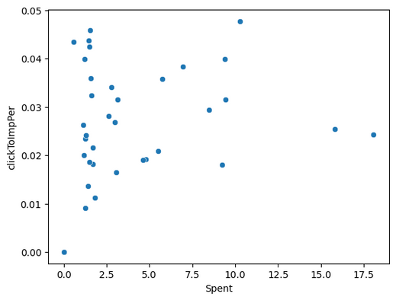
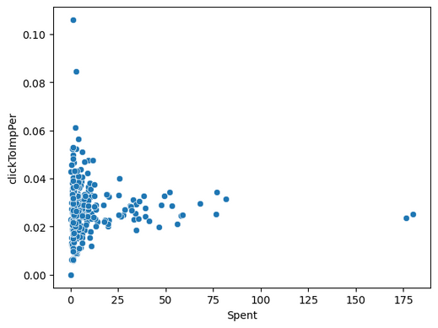
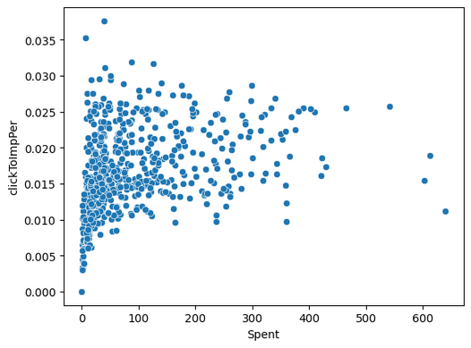
Question 4:
Assessing individual campaign performances to identify the most effective creative/campaign for potential reruns with adjusted audiences.
Plot Click to Impression ratio vs Expenditure for the companies
Plot for Total Conversions per Click for each Company
Click to Impression ratio vs Expenditure for Company 1
Click to Impression ratio vs Expenditure for Company 2
Click to Impression ratio vs Expenditure for Company 3

Slide 14
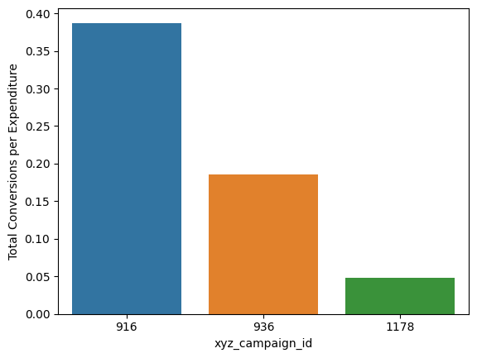
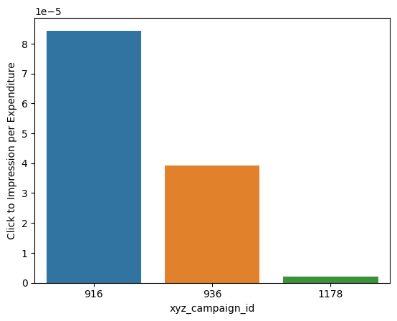
Question 4:
Company 1
Company 2
Company 3
1. Company 3 attains a higher total number of conversions, mainly due to its abundance of data points.
2. Company 2 exhibits a superior click-to-impression ratio.
3. Company 1 outperforms in terms of total conversions per expenditure, click-to-impression ratio per expenditure, and total conversions per click, making it the top performer.
4. Consequently, Company 1 demonstrates the most favorable campaign performance.

Slide 15
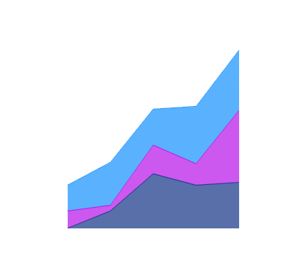

CONCLUSION
All the columns are fairly correlated with each other
In Campaign_3 and Campaign_2, the age group of 30-34 shows more interest whereas in Campaign_1 the age group of 40-44 shows more interest.
Both the genders shows similar interests in all three campaigns.
men tend to click more than women but women buy more products than men after clicking the add.People in age group 30-34 has more tendency to buy product after clicking the add.

Slide 16
Chop Chop
Brothers
THANK YOU
For watching this presentation

